Slide 1
STELLAR OBJECT CLASSIFICATION
A Machine Learning Approach to Astronomical Survey Data

Slide 2
Agenda : Stellar Object Prediction
Introduction
Data Collection
Exploratory Data Analysis (EDA) And Visualisation
Data Preprocessing
Machine Learning Model Development
Model Deployment
Dashboard Creation

Slide 3
Introduction : Stellar Object Classification
Leveraging Machine Learning for Astronomical Discoveries
Project Overview:
This project employs machine learning to classify celestial objects into three categories:
Stars
Galaxies
Quasars
Significance:
Automates large-scale data classification for astronomical surveys.
Provides key insights into the distinguishing features of celestial objects.
Optimizes processing model for efficient research and discovery.

Slide 4
Impacts on Astronomical Research
1. Enhanced Efficiency:
Automated Classification: Enables rapid categorization of celestial objects from vast survey datasets.
Scalability: Can handle the ever-growing volume of astronomical data.
2. Informed Research Decisions:
Key Feature Insights: Identifies the most significant attributes distinguishing stars, galaxies, and quasars.
Predictive Accuracy: Guides astronomers to focus on high-confidence classifications.
3. Optimized Data Processing Pipelines:
Selection of the best-performing algorithms supports efficient integration into existing systems for large-scale surveys.
4. Catalyst for Innovation:
Algorithmic Advancements: Comparative analysis may inspire further model refinements and hybrid approaches.
Cross-disciplinary Applications: Techniques may be applicable in other domains requiring object classification.

Slide 5
Project Objectives
Automated Classification: Efficiently categorize celestial objects into stars, galaxies, and quasars.
Insightful Analysis: Identify key features that distinguish celestial object types.
Optimized Data Processing: Evaluate algorithms to enhance large-scale survey data handling.

Slide 6






Steps:
Acquire Data
|
Clean
Acquire Data
Reformat And Cleaning
Transform And Visualize
Model And Validate
Reporting And Deploying
|
Visualize
|
Validate
|
Train Test
|
Deploy

Slide 7
Data Collection
Dataset: Stellar Object Classification Dataset (star_classification.csv)
Description: Contains astronomical data for celestial objects, used to classify them into stars, galaxies, and quasars.
Purpose:Used to classify celestial objects into stars, galaxies, and quasars based on various astronomical features and measurements.
Applications:Astronomical Classification: Categorizing celestial objects to support research and discovery.
Analysis Tasks: EDA, data preprocessing, ML model building, evaluation, and model deployment.

Slide 8
Dataset Overview
Key Features of the Dataset:
obj_ID: Unique identifier for each object.
alpha, delta: Right Ascension and Declination angles (at J2000 epoch).
u, g, r, i, z: Photometric filters (Ultraviolet to Infrared).
run_ID & rerun_ID: Identifiers for specific scans and image processing.
class: Object classification (star, galaxy, or quasar).
redshift: Redshift value based on wavelength increase.
plate, MJD, fiber_ID: Identifiers for SDSS data, observation time, and fiber location.

Slide 9
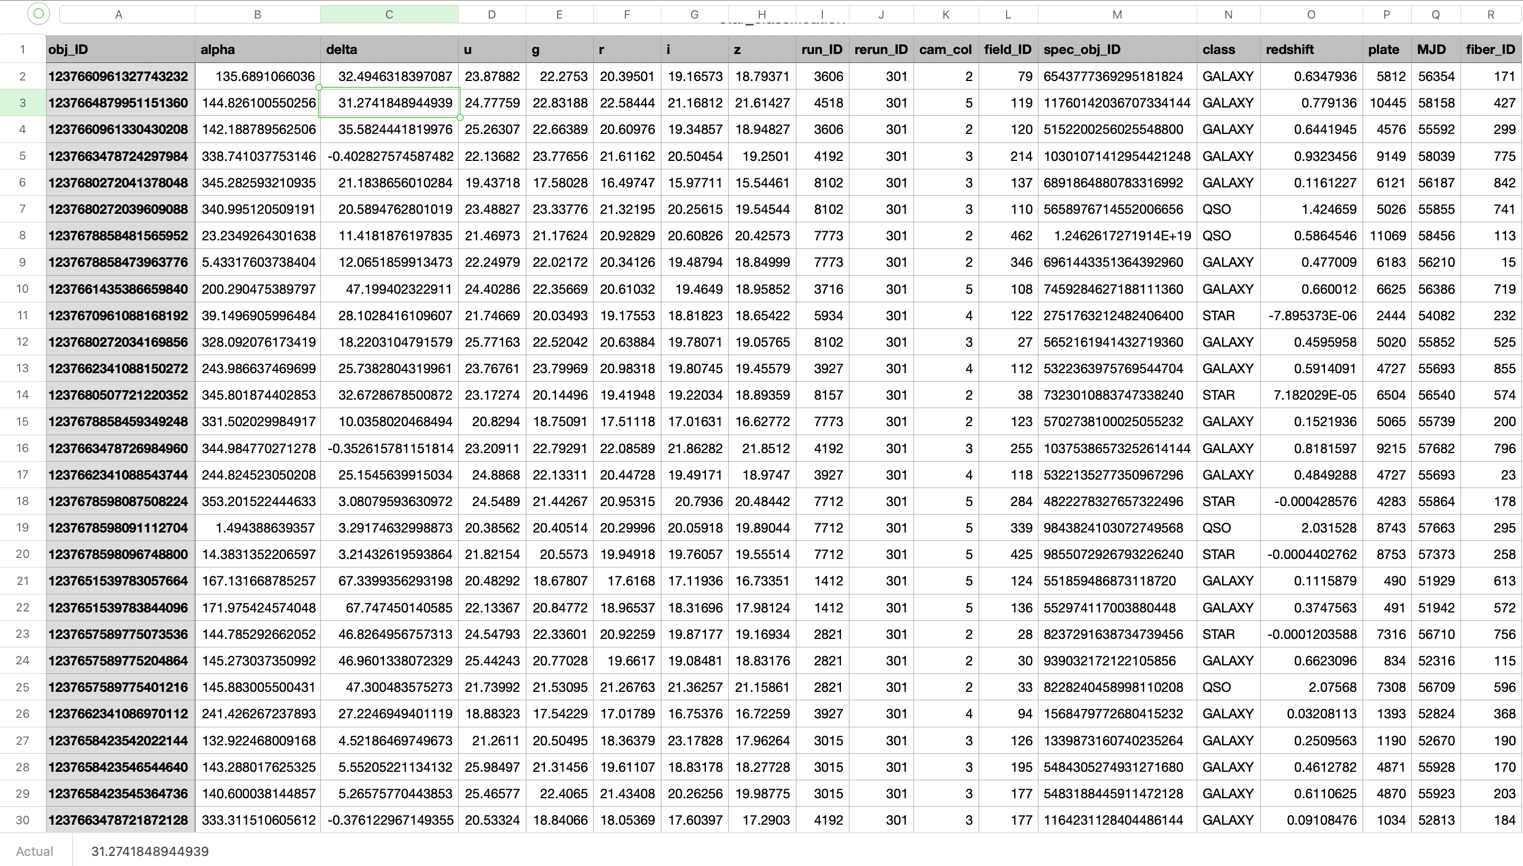
Dataset Overview

Slide 10
Data Preprocessing
Handling Missing Values
Discuss strategies for addressing missing data, such as imputation or removal.
Dealing with Outliers
Identify and address outliers that can impact model performance.
Encoding Categorical Variables
Explain techniques to convert categorical data into a format suitable for machine learning models.
Splitting Data into Training and Testing Sets
Emphasize the importance of dividing data for model training and evaluation.

Slide 11
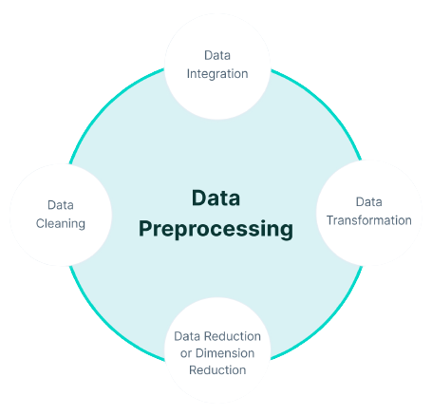
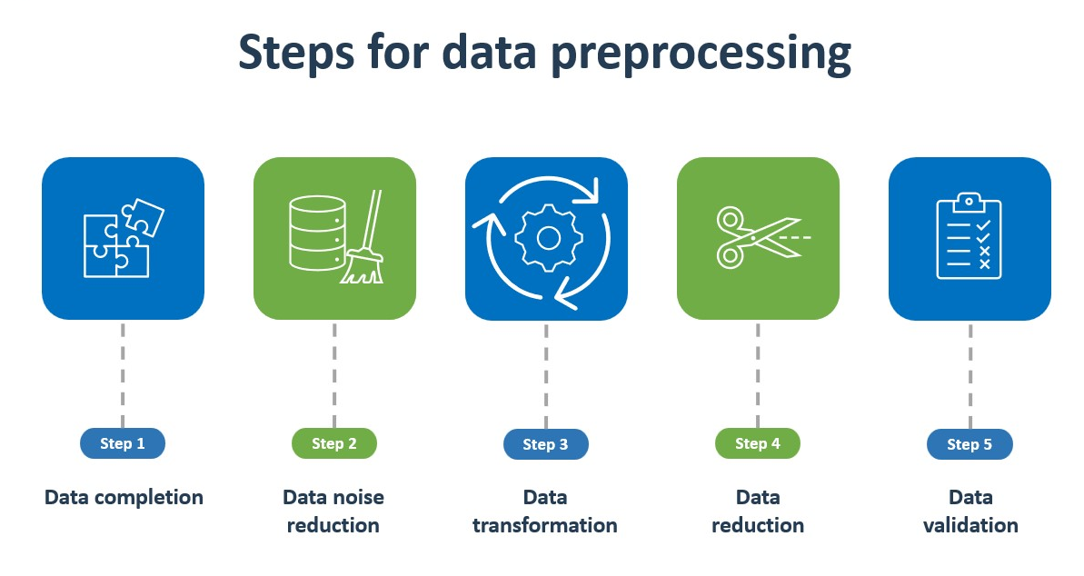
Data Preprocessing

Slide 12
Data Preprocessing
Explored Features:
Astronomical Angles: Analyzed the distribution of Right Ascension (alpha) and Declination (delta) for celestial objects.
Photometric Filters: Investigated the distribution of measurements from UV to Infrared filters (u, g, r, i, z).
Redshift & Class: Examined the redshift values and object classification (Star, Galaxy, Quasar).
Identifiers: Reviewed the impact of object identifiers (obj_ID, plate, MJD) on classification accuracy.
Key Insights:
Balanced Distribution: The dataset has a relatively balanced distribution of object classes (Stars, Galaxies, Quasars).
Feature Correlation: Strong correlations were found between certain photometric filters (g, r, z) and object classification.
Redshift: Objects with higher redshift values tend to be classified as galaxies or quasars.
Filter Significance: UV and infrared filters (u, z) provide the most discriminative features for classification.

Slide 13
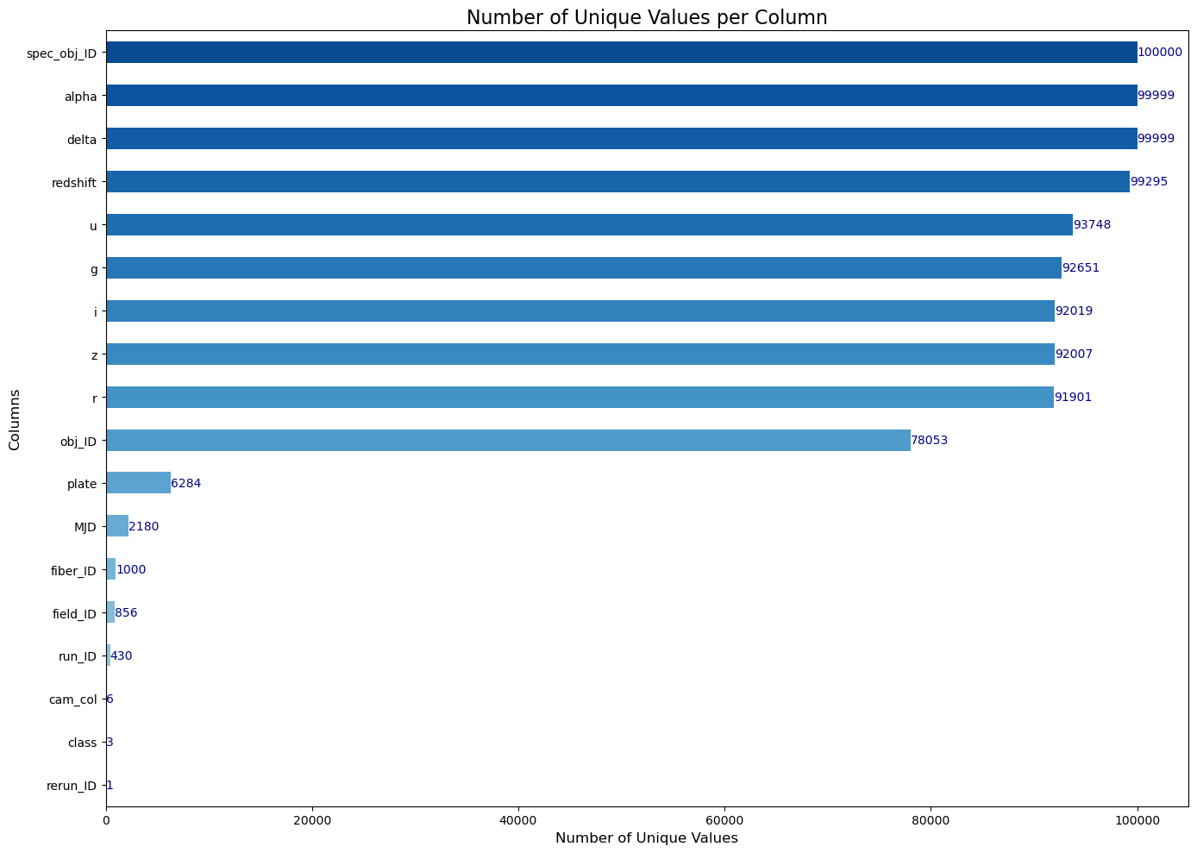
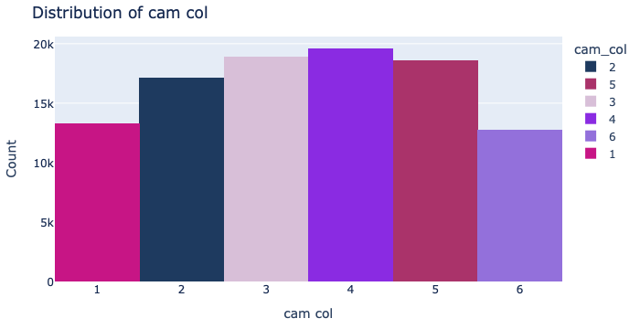
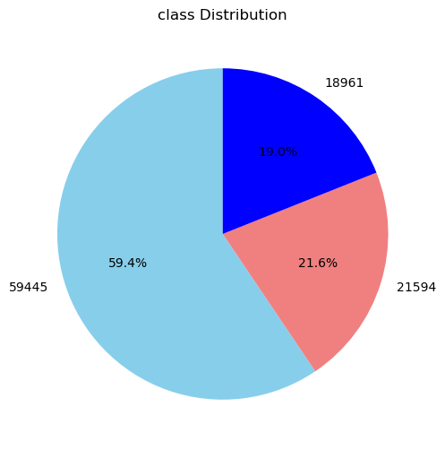
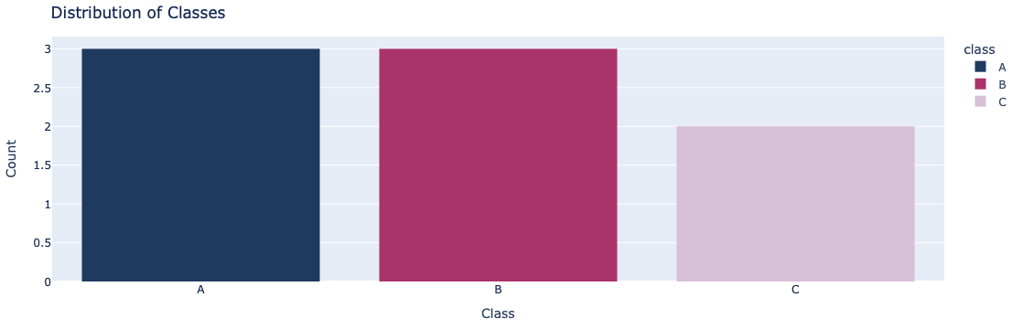
Exploratory Data Analysis (EDA)

Slide 14
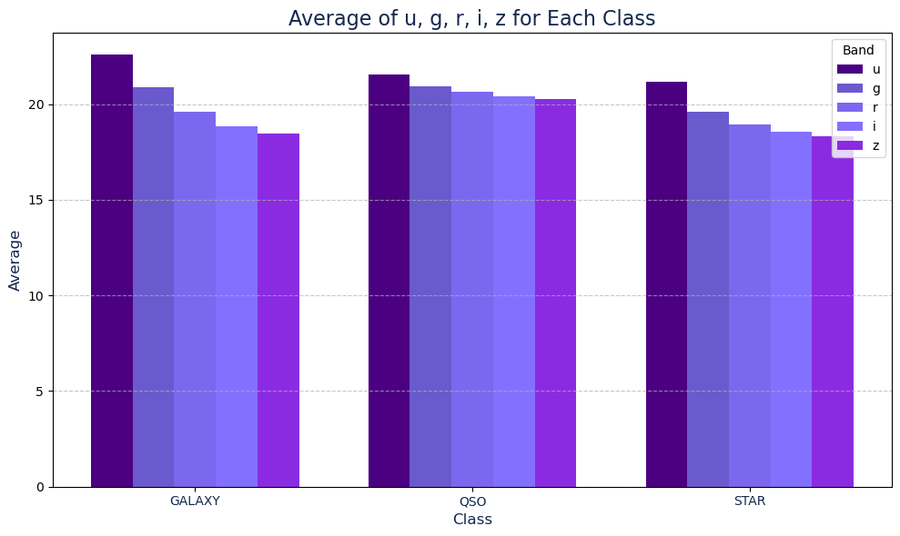
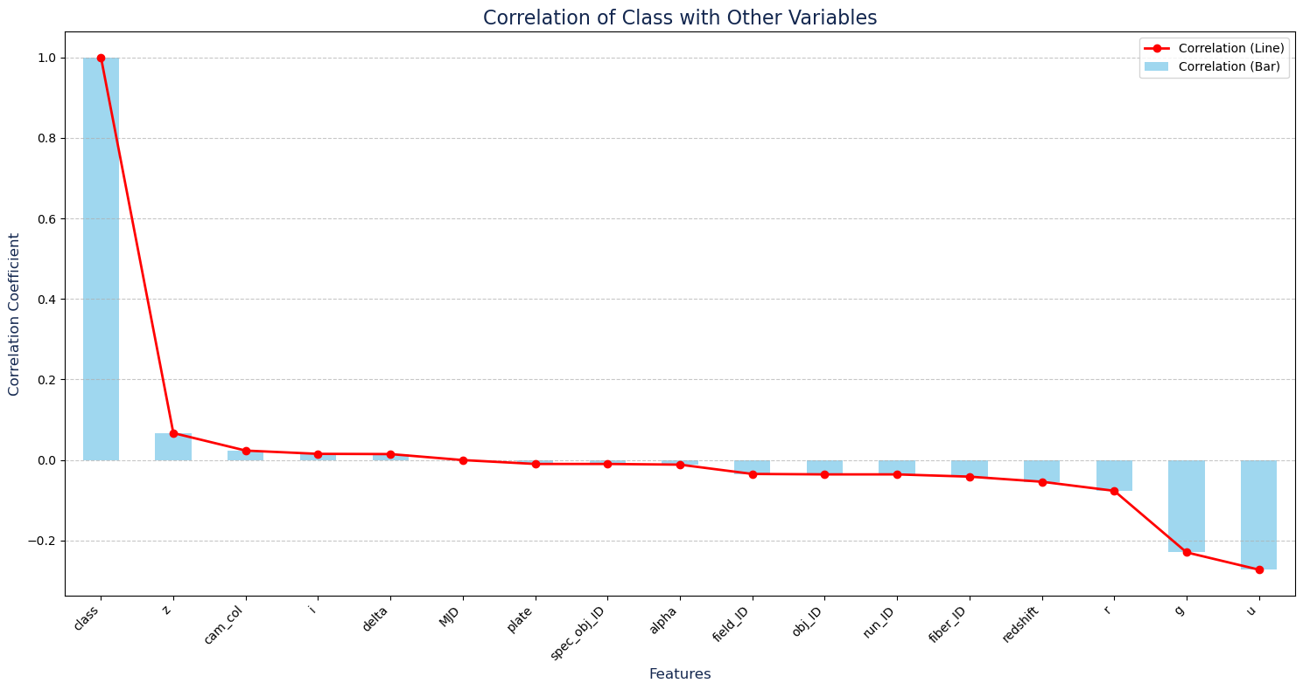
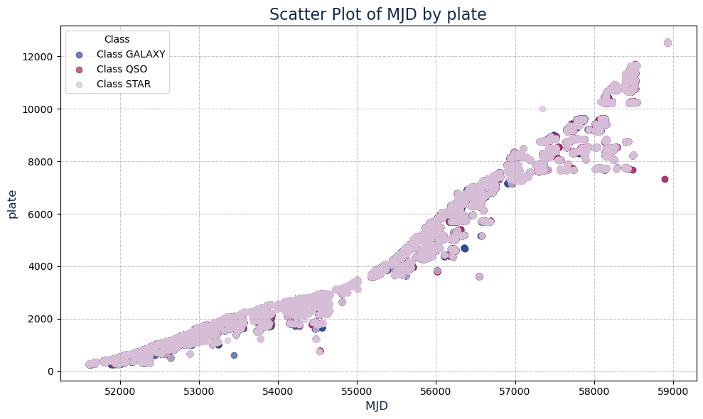
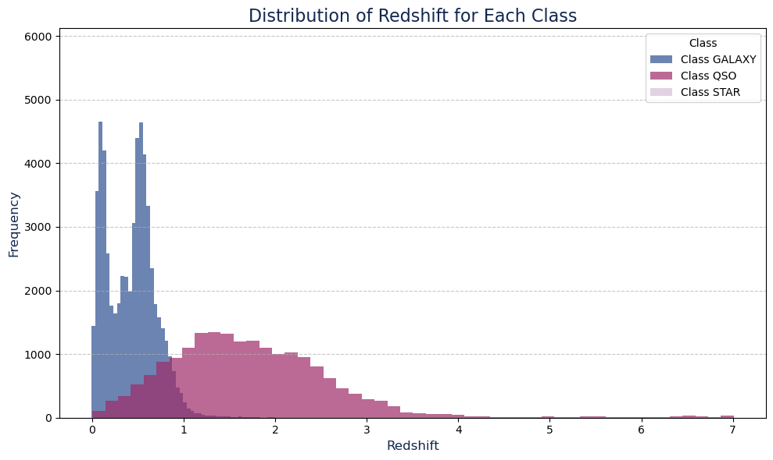
Exploratory Data Analysis (EDA)

Slide 15
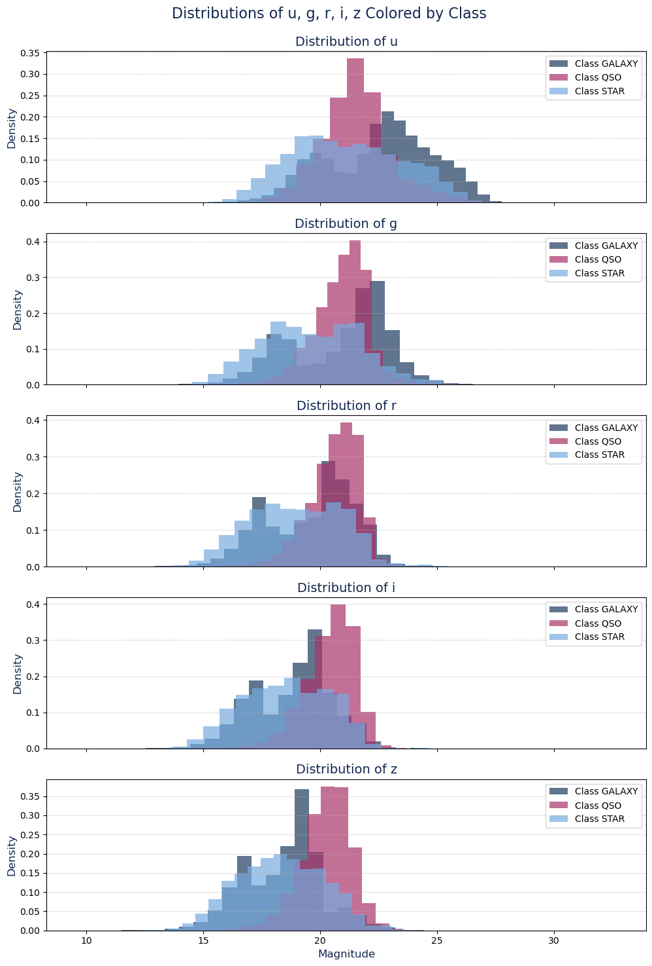
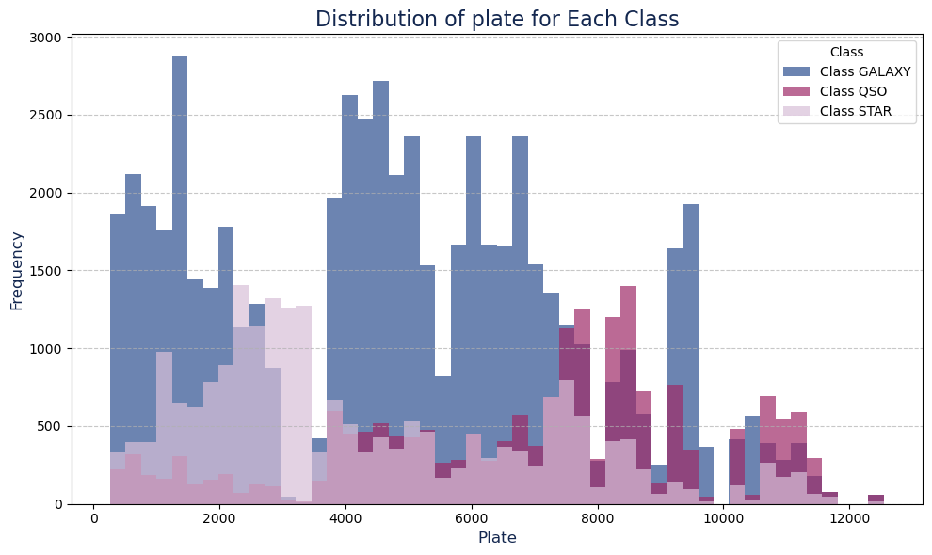
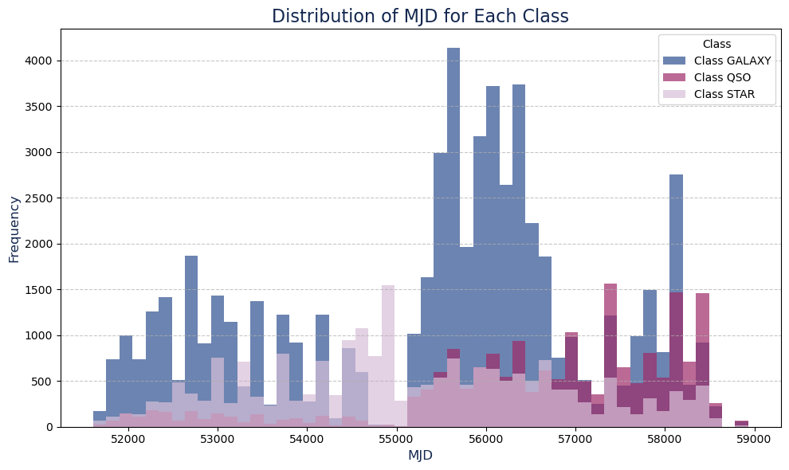
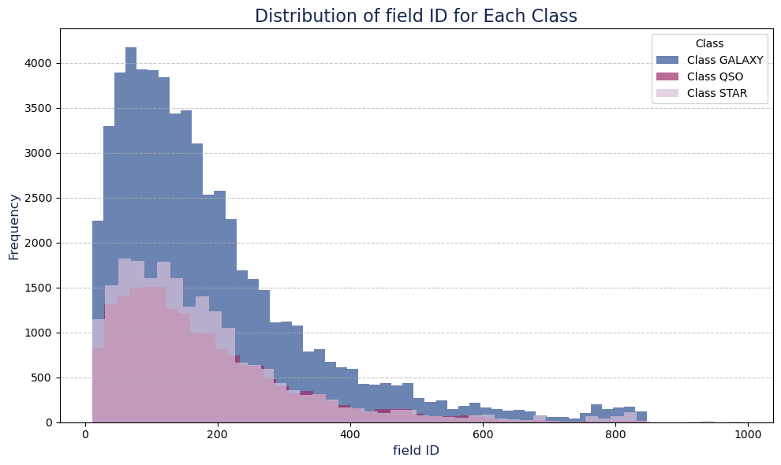
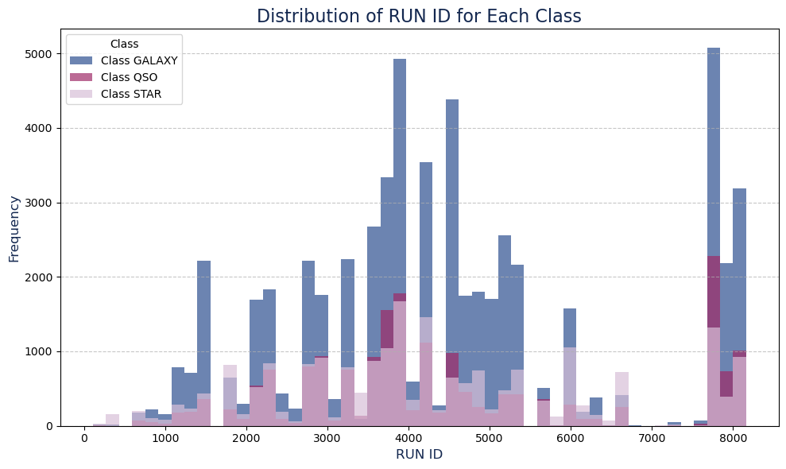

Slide 16
Machine Learning Model Development
Choosing a Machine Learning Algorithm: Select the right algorithm (e.g., Logistic Regression, Random Forest, SVM, Adaboost, XG Boost) for your problem.
Training and Evaluating the Model: Cover the process of training and evaluating the model to ensure its robust and reliable.
Hyperparameter Tuning: Optimize model parameters for improved performance.
Model Evaluation Metrics: Use metrics like accuracy, precision, and recall to assess how well the model is performing.

Slide 17
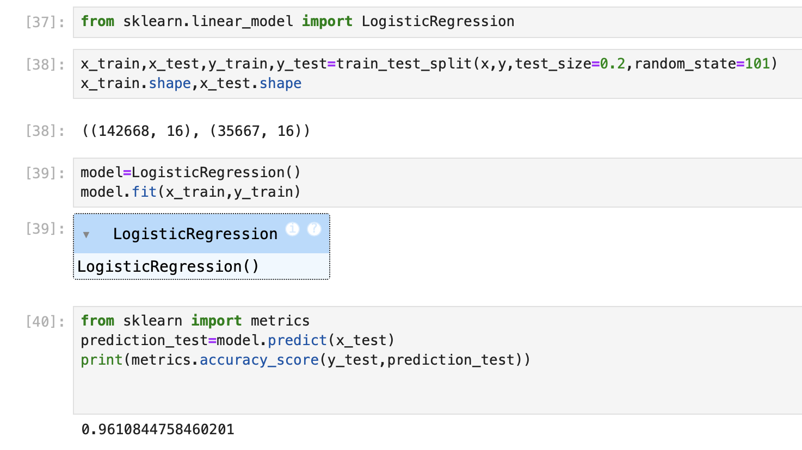
Machine Learning Model Development
Supervised Learning:
Logistic Regression:
Type: Supervised learning algorithm used for classification tasks.
Concept: It models the relationship between the dependent binary variable (target) and one or more independent variables by estimating probabilities using a logistic function. It's suitable for binary classification.

Slide 18
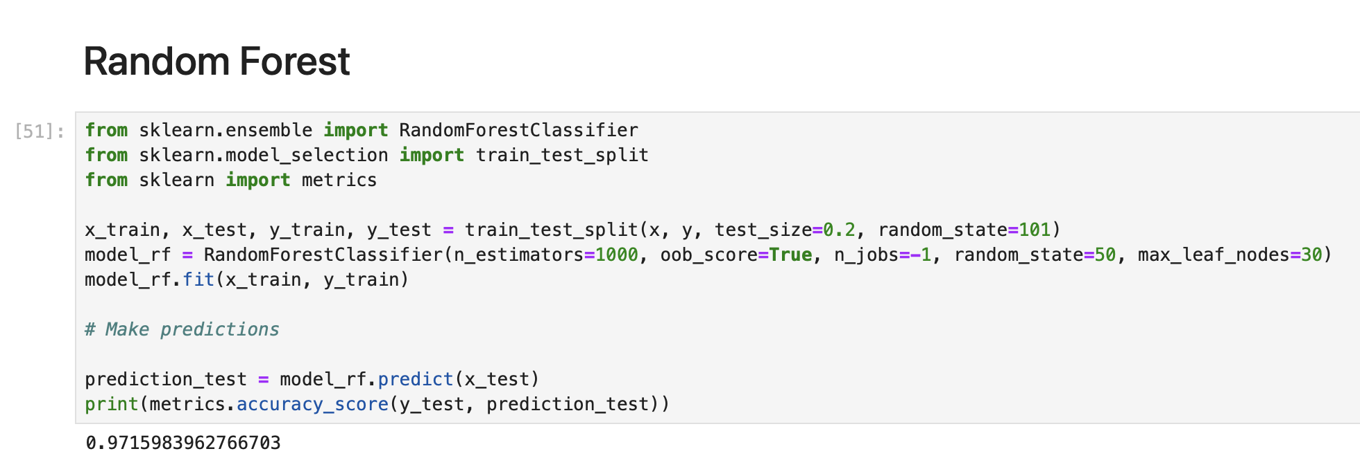
Machine Learning Model Development
2. Random Forest:
Type: Ensemble learning method, specifically a bagging algorithm.
Concept: It builds multiple decision trees and combines their predictions to produce a more accurate and robust result. Each tree in the forest is trained on a random subset of the data.

Slide 19
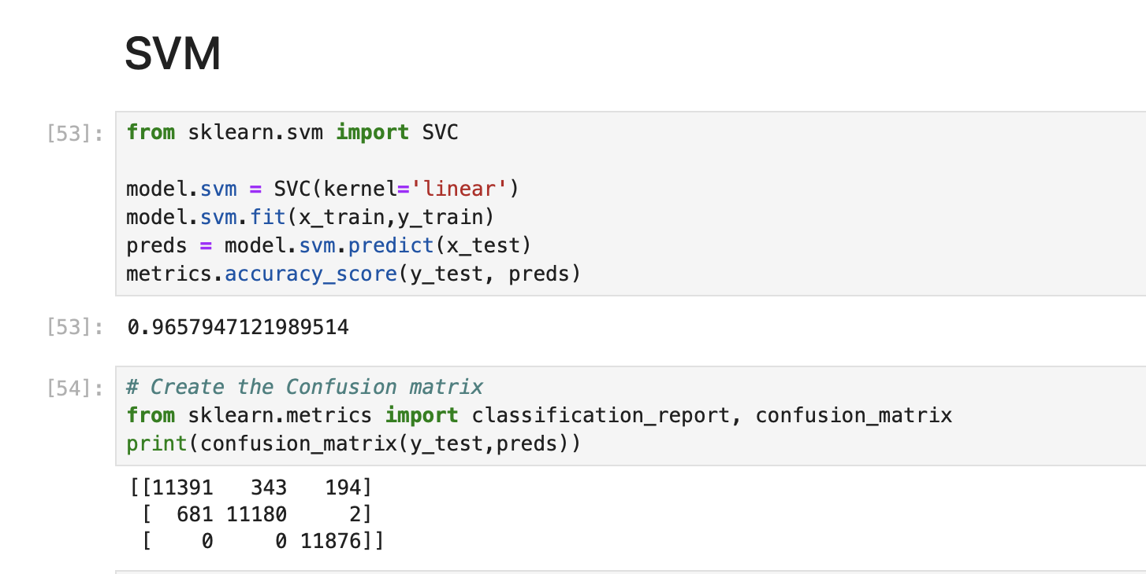
Machine Learning Model Development
3. Support Vector Machine (SVM):
Type: Supervised learning algorithm used for classification and regression tasks.
Concept: SVM finds a hyperplane that best separates data points of different classes. It aims to maximize the margin between the classes while allowing for a small number of misclassifications.

Slide 20
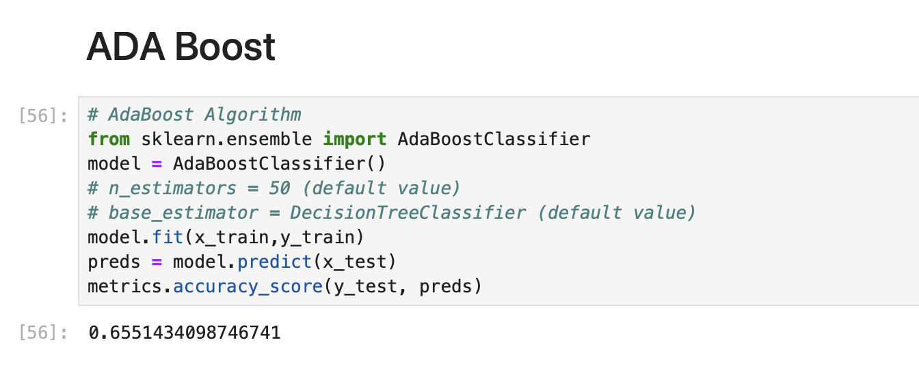
Machine Learning Model Development
4. Adaboost:
Type: Ensemble learning method, specifically a boosting algorithm.
Concept: Adaboost combines multiple weak classifiers to create a strong classifier. It assigns weights to data points, giving more importance to misclassified points, and iteratively improves the model.

Slide 21
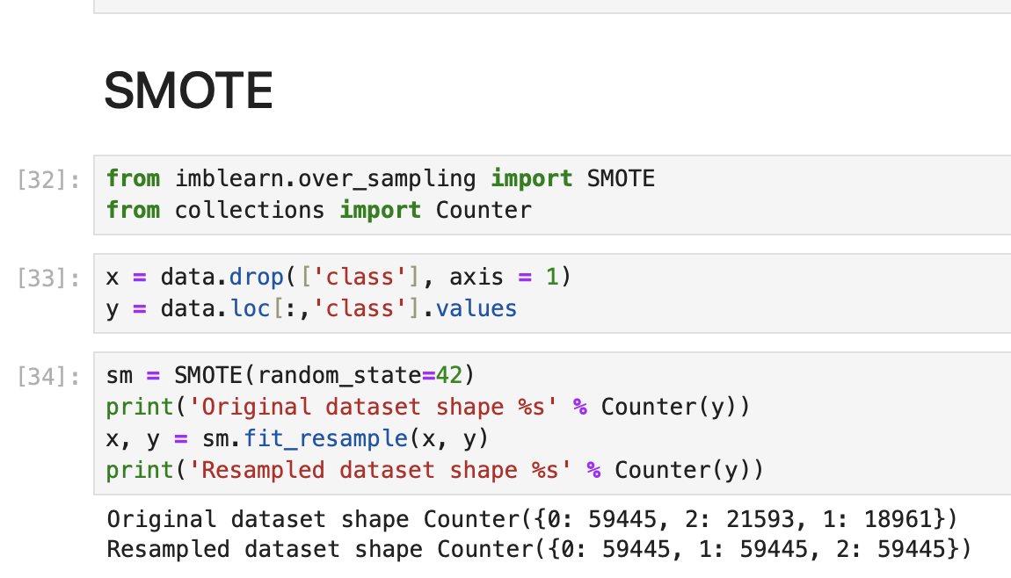
Machine Learning Model Development
SMOTE: Synthetic Minority Over-sampling Technique
SMOTE is a technique used to address class imbalance by generating synthetic data points for the minority class. It works by creating new samples that are combinations of the features of the nearest neighbors in the minority class.
Outcome:
Improved Model Performance: SMOTE helped to improve model performance by providing a more balanced dataset, leading to better generalization and reduced bias towards the majority class.
Balanced Dataset: Ensured equal representation of all object classes (Stars, Galaxies, and Quasars) during model training

Slide 22
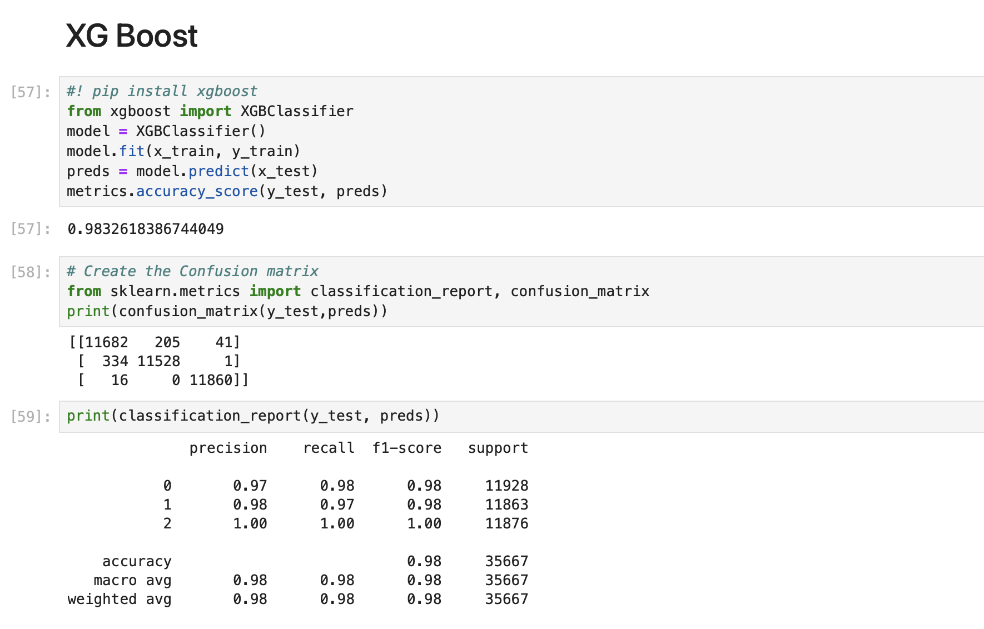
Machine Learning Model Development
5. XG Boost (Extreme Gradient Boosting):
Type: Ensemble learning method, specifically a boosting algorithm.
Concept: XG Boost is an advanced gradient boosting algorithm known for its efficiency and performance. It builds decision trees sequentially, focusing on minimizing the loss function. It uses gradient descent for optimization.

Slide 23
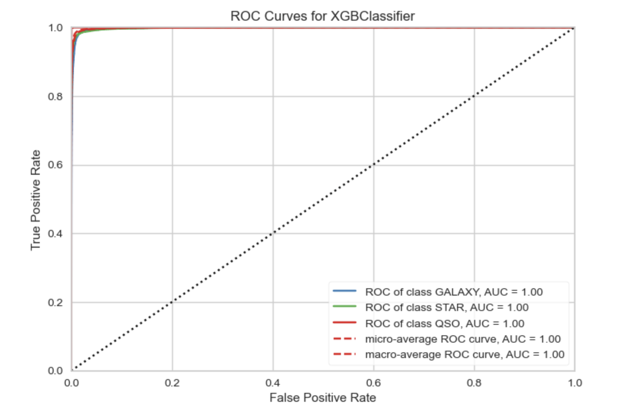
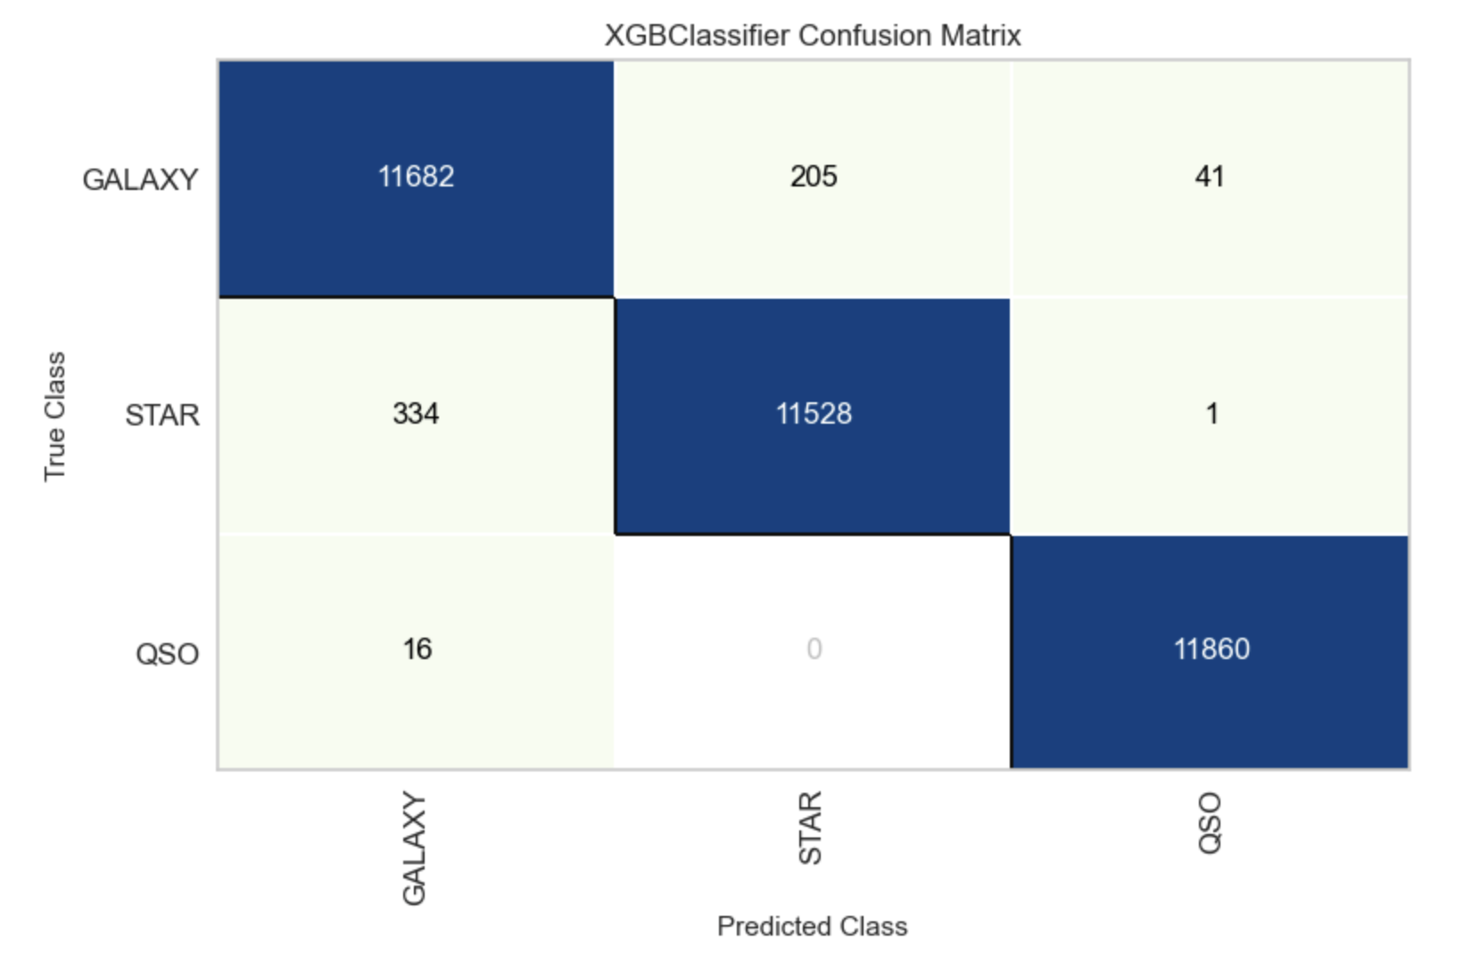
Machine Learning Model Development
Model Performance:
Logistic Regression: Accuracy - 96.1%
Random Forest: Accuracy - 97.1%
Support Vector Machine (SVM): Accuracy - 96.5%
ADA Boost: Accuracy - 65.5%
XG Boost: Accuracy - 98.3%
Model Interpretation: XGBoost
Feature Importance:
Top Features: g, r, z filters, and Redshift.
Interpretation: These features are key for distinguishing stars, galaxies,
and quasars.
Performance:
Accuracy: High, with balanced performance across all classes.
Precision/Recall: Best for Quasars, with strong F1-scores.

Slide 24
Recommendations
By applying machine learning techniques like XGBoost to classify celestial objects, the project provides valuable insights into the distinguishing features of stars, galaxies, and quasars.
The combination of exploratory data analysis and predictive modeling offers a deeper understanding of celestial phenomena, enabling astronomers to make more accurate classifications in large-scale surveys.
The model's ability to classify objects with high accuracy empowers future astronomical research and supports data-driven decision-making in space exploration.
Collaboration with Research Institutions: Partner with astronomical research institutions to validate predictions and refine the model further by incorporating expert feedback and new data.

Slide 25
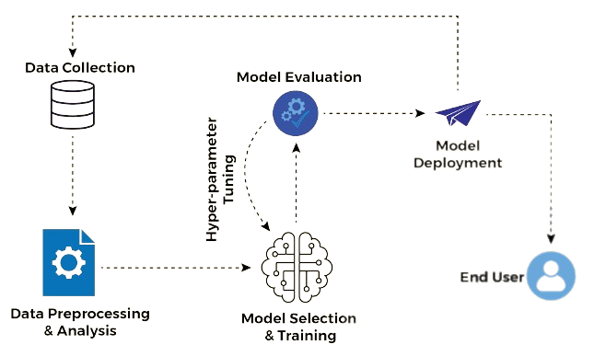
Introduction to Model Deployment
Model deployment is the process of making a trained machine learning model available for use in real-world applications.
It involves taking a model from the development and testing phase and integrating it into a production environment.

Slide 26


Setting Up a Deployment Environment
Streamlit:
Open-source Python library for creating web apps.
Ideal for data scientists to quickly build interactive apps.
Transforms data scripts into shareable web apps.
Used for dashboards, visualizations, and ML model interfaces.
Simplifies web-based UI development in Python.
Spyder:
Integrated Development Environment (IDE).
Tailored for data science, scientific, and engineering projects.
Features code editing, variable explorer, and debugging.
Supports data analysis libraries (NumPy, SciPy, pandas).
Used for writing, testing, and debugging Python code.
Ideal for data analysis and scientific computing tasks.

Slide 27
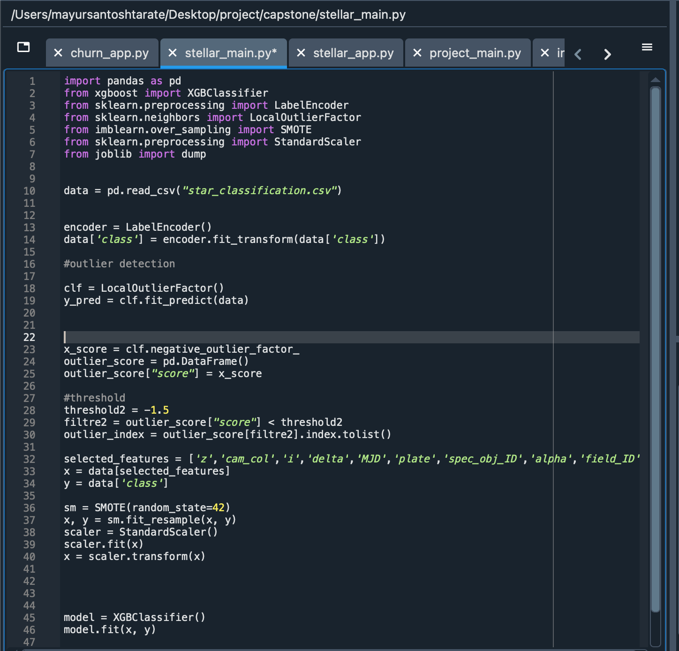
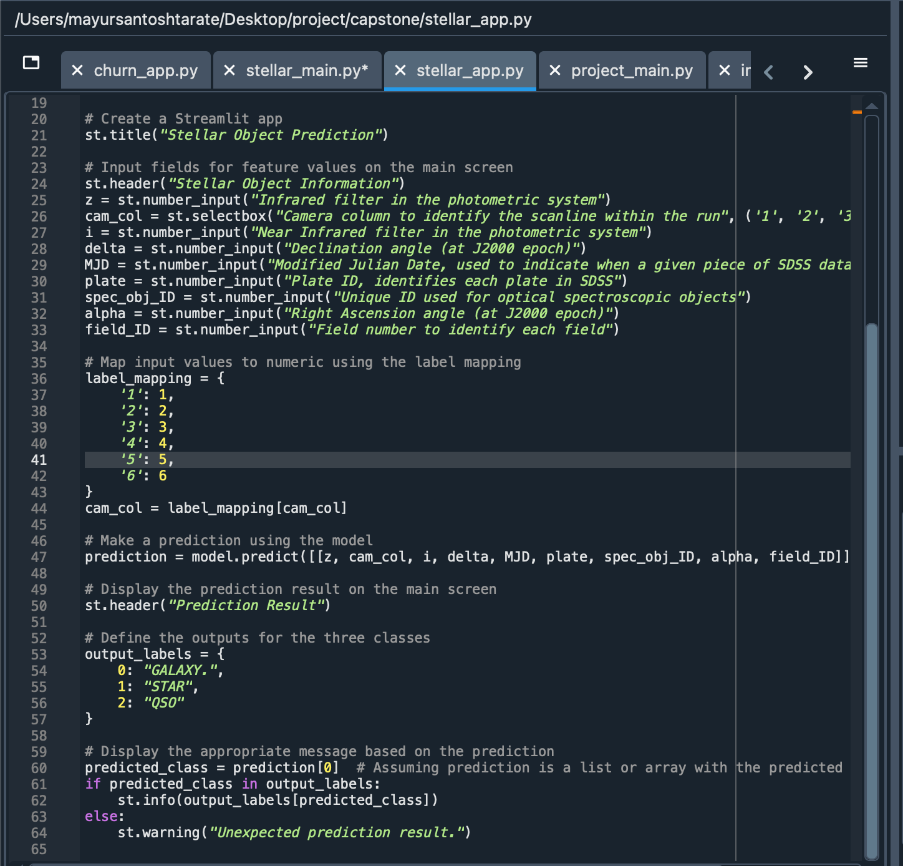
Model Deployment
ML Model File- stellar_main.py
Streamlit Web App File- stellar_app.py

Slide 28
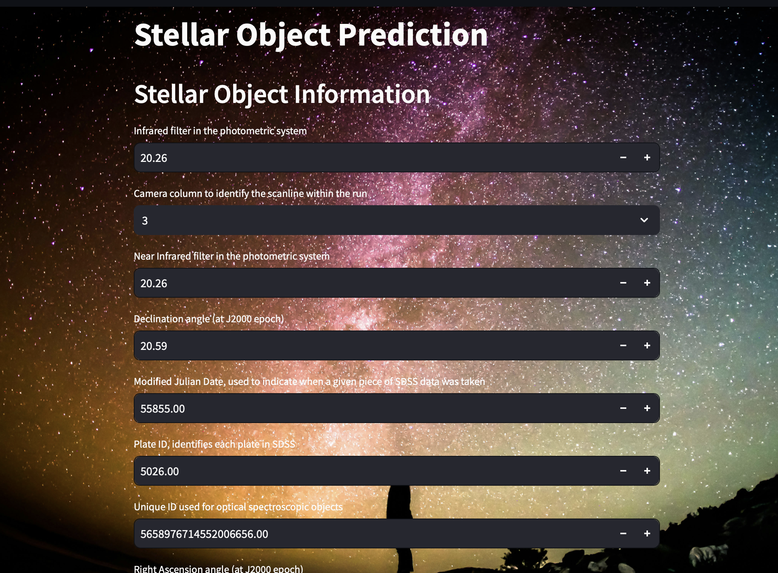
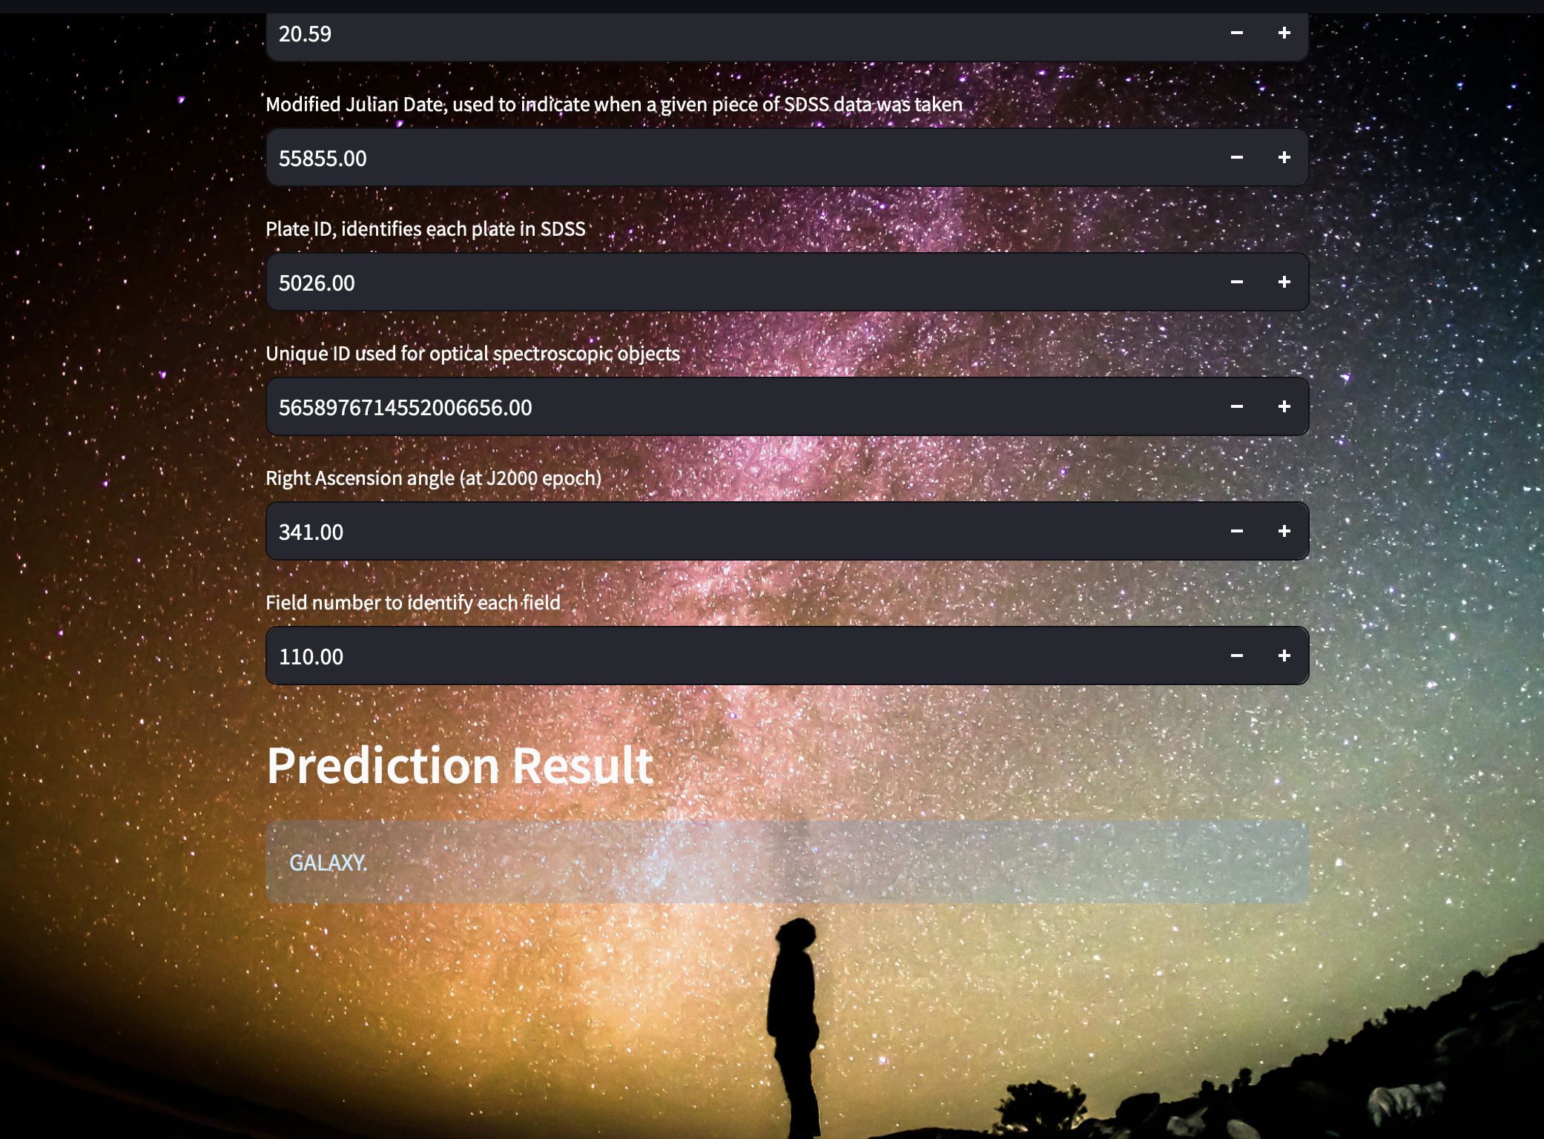
Model Deployment
Streamlit web app for Stellar Object Classification App

Slide 29
Thank You!

